Slide 1
Module 15

Slide 2

CONSTRUCTIONS
To construct tangents to a circle from an external point.
Notes:
School
2

Slide 3
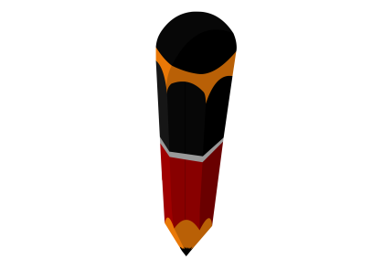
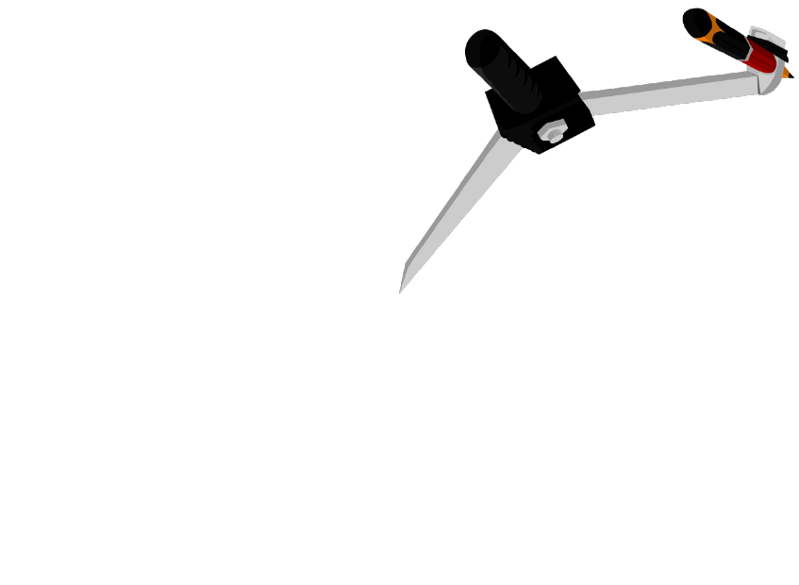
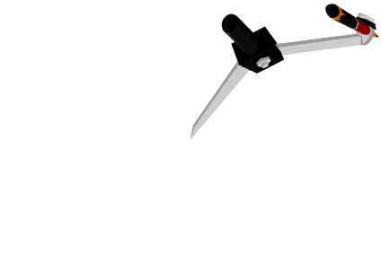


Ex-13.2 (Q.3)
Q. Draw a circle of radius 3cm.
Take two points P and Q on
one of its extended diameters
each at a distance of 7cm
from its centre. Draw tangents
to the circle from these two
points P and Q.
PA and PB are required tangents from external point P
Draw a circle intersecting previously drawn circle at C and D
Q as centre and radius more than half of OQ, draw arcs on either sides
Now O as centre and with the same radius, cut previously drawn arcs
O as centre and radius more than half of OP, draw arcs on either sides
QC and QD are required tangents from external point Q
Draw a circle intersecting previously drawn circle at A and B
Draw perpendicular bisector of seg OQ
Now N as centre and radius = ON or NQ
Now P as centre and with the same radius, cut previously drawn arcs
Draw perpendicular bisector of seg OP
Draw line GH
intersecting OQ at N
Now M as centre and radius = OM or MP
Draw line EF intersecting OP at M
Locate points P and Q such that OP = OQ = 7cm
Draw a circle of radius of 3cm and centre O
Draw ray QC and QD
Draw ray PA and PB
G
E
C
A
1
2
3
4
5
6
7
8
9
10
11
12
13
14
15
1
2
3
4
5
6
7
8
9
10
11
12
13
14
15
N
Q
7 cm
O
M
7 cm
P
1
2
3
4
5
6
7
8
9
10
11
12
13
14
15
Rough Figure
1
2
3
2
4
5
6
7
8
9
10
11
12
13
14
15
1
2
3
4
5
6
7
1
8
9
3
4
5
6
7
8
9
10
11
12
13
14
15
1
2
3
4
5
6
7
8
9
10
11
12
13
14
15
10
11
12
13
14
15
D
B
C
A
3 cm
H
F
Q
7 cm
O
7 cm
P
D
B
1
2
3
4
5
6
7
8
9
1
2
3
4
5
6
7
8
9
10
11
12
13
14
15
10
11
12
13
14
15

Slide 4
Q. Draw a circle of radius 3cm. Take two points P and Q on one of its extended diameters
each at a distance of 7cm from its centre. Draw tangents to the circle from these two
points P and Q.
Justification :
Join OA then ∠OAP is an angle in a semicircle.
C
A
∴
∠OAP = 90°
∴
line PA ⊥ radius OA.
N
∴
Q
7 cm
O
M
7 cm
P
PA has to be a tangent to circle
[A line ⊥ to radius to a circle
at its outer end is a tangent]
D
B
Similarly, we can show that PB, QC and QD
are the tangents.

Slide 5
Module 16

Slide 6
CONSTRUCTIONS
To construct tangents to a circle from an external point.
Notes:
School
6

Slide 7




Q. Draw a pair of tangents to a circle of radius 5cm which are inclined to each
other at an angle of 60º.
F as centre and radius more than half of FG, draw arcs on either sides
G
O as centre and any suitable radius draw an arc intersecting OA at C
Now G as centre and with the same radius, cut previously drawn arcs
Now K as centre and with the same radius, cut previously drawn arc
J as centre and radius more than half of JK, draw an arc
Draw a circle of radius of 5cm and centre O
A as centre,
draw arcs
C as centre and same radius cut an arc at D
D as centre and same radius cut an arc at E
B as centre,
draw arcs
Rough Figure
H
Draw line HI
Draw line OA
Draw OE
Draw ∠O = 120º
A
Draw line BL
I
A
F
5 cm
5 cm
O
120º
60º
1
2
3
4
5
6
7
8
9
P
P
60º
10
11
12
13
14
15
1
2
3
4
5
6
7
8
9
C
10
11
12
13
14
15
B
O
D
In oAOBP,
∠AOB + ∠OAP + ∠P + ∠OBP = 360º
∠AOB + 90 + 60 + 90 = 360
∠AOB + 240 = 360
∠AOB = 360 – 240
∠AOB = 120º
120º
∴
E
∴
1
2
3
K
∴
4
5
6
7
8
9
10
11
12
13
14
15
1
2
3
4
5
6
7
8
9
10
11
12
13
14
15
∴
B
J
L
1
2
3
4
5
6
7
8
9
10
11
12
13
14
15

Slide 8

Q. Draw a pair of tangents to a circle of radius 5cm which are inclined to each
other at an angle of 60º.
Justification :
$$∵$$
PA and PB are ⊥ to radii OA and OB.
A
Hence PA and PB are the tangents
to the circle.
5 cm
P
60º
O
120º
B

Slide 9
Module 17

Slide 10
CONSTRUCTIONS
To construct tangents to a circle from an external point.
Notes:
School
10

Slide 11

Ex-13.2 (Q.5)
X
Q. Draw a line seg AB of length 8 cm.
Taking A as centre, draw a
circle of radius 4 cm & taking B
as centre draw another circle of
radius 3 cm. Construct tangents
to each circle from the centre
of other circle.
B as the centre and same radius, draw another arc
Now B as centre and with the same radius, cut previously drawn arcs
A as centre and radius more than half of AB, draw arcs up and down
AP and AQ are required tangents from external point A
R
BR and BS are required tangents from external point B
Draw a circle intersecting circles
at P,Q,R,S
Draw another circle of radius 3cm and centre B
Any point on the line as centre and radius = 8 cm, draw an arc
Now M as centre and radius = AM or MB
Draw seg BR, BS, AQ and AP
Draw line XY intersecting AB at M
Draw perpendicular bisector of seg AB
Draw a circle of radius 4cm and centre A
P
Draw seg AB = 8cm
1
2
3
4
4 cm
7
8
9
1
2
3
5
6
7
10
11
12
13
14
15
4
5
6
8
9
10
11
12
13
14
15
3 cm
Rough Figure
R
P
1
2
3
4
5
6
7
8
9
10
11
12
13
14
15
B
8 cm
A
M
4 cm
3 cm
1
2
3
4
5
6
7
8
9
10
11
12
13
14
15
1
2
3
4
5
6
7
8
9
10
11
12
13
14
15
A
8 cm
B
1
2
3
4
5
6
7
8
9
10
11
12
13
14
15
1
1
2
2
3
3
4
4
5
5
6
6
7
7
8
8
9
9
10
11
12
13
14
15
S
Q
10
11
12
13
14
15
Q
S
Y
1
2
3
4
5
6
7
8
9
10
11
12
13
14
15

Slide 12
Q. Draw a line seg AB of length 8 cm. Taking A as centre, draw a circle of
radius 4 cm & taking B as centre draw another circle of radius 3 cm.
Construct tangents to each circle from the centre of other circle.
Justification :
Draw AR
R
P
∠ARB is an angle in a semicircle.
4 cm
∴
∠ARB = 90°
3 cm
∴
BR ⊥ radius AR
8 cm
B
A
M
∴
BR is a tangent to circle
[A line ⊥ to radius to a circle
at its outer end is a tangent]
Q
S
Similarly, we can show that BS, AP and AQ
are the tangents.

Slide 13
Module 18

Slide 14
CONSTRUCTIONS
To construct tangents to a circle from an external point.
Notes:
School
14

Slide 15



Ex-13.2 (Q.6)
C
Q. Let ABC be a right triangle in which
AB = 6 cm, BC = 8 cm & ∠B = 90º.
BD is the perpendicular from B on AC.
The circle through B,C,D is drawn.
Construct tangents from A to this
circle.
Any point on the line as centre and radius = 6 cm, draw an arc
E as centre and radius more than half of EF, draw an arc
B as centre and radius more than half of BC, draw arcs left and right
B as centre and radius = 8cm, draw an arc
A as the centre and same radius, draw another arc
Now C as centre and with the same radius, cut previously drawn arcs
Now A as centre and radius = AB, draw an arc intersecting circle at P
B as centre, draw arcs intersecting line AB at E and F
Now F as centre and with the same radius, cut previously drawn arc
B as a centre and radius more than distance of AC, draw 2 arcs at AC
Now I as centre and with the same radius, cut previously drawn arc
Draw perpendicular bisector of seg HI
H as centre and radius more than half of HI, draw an arc
Now X as centre and radius = BX or CX
Draw a circle
Draw line BJ
Draw line BG
Draw line KL
Draw AP
Draw AC
Draw seg AB = 6cm
P
H
Rough Figure
K
L
J
C
8 cm
1
2
3
4
X
7
8
9
5
6
10
11
12
13
P
14
15
1
2
3
4
5
G
7
8
9
D
1
2
3
6
7
10
11
12
13
14
15
8 cm
4
5
6
8
9
10
11
12
13
14
15
D
1
2
3
4
5
6
1
7
2
8
3
9
10
11
12
13
14
15
4
5
6
7
8
9
10
11
12
13
14
15
I
B
6 cm
A
E
B
F
6 cm
A
1
2
3
4
5
6
7
8
9
10
11
12
13
14
15
1
2
3
4
5
6
7
8
9
10
11
12
13
14
15

Slide 16
Q. Let ABC be a right triangle in which AB = 6 cm, BC = 8 cm and ∠B = 90º.
BD is the perpendicular from B on AC. The circle through B,C,D is drawn.
Construct tangents from A to this circle.
Justification :
C
∠ABX = 90° hence AB ⊥ radius XB
∴
AB is a tangent to circle
P
[A line ⊥ to radius to a circle
at its outer end is a tangent]
8 cm
Length of the tangents drawn to a
circle from an external point are
always equal.
X
D
Hence, AP is other tangent to the circle.
B
6 cm
A

Slide 17
Module 19

Slide 18
CONSTRUCTIONS
To construct circumcircle of the
given triangle.
To construct tangents from an
external point to this circumcircle.
Notes:
School
18

Slide 19

Ex-13.2 (Q.7)
Q. Draw a circle with the help of a
triangle. Take a point outside the
circle. Construct the pair of tangents
from this point to the circle.
B as centre and radius more than half of AB, draw arcs left and right
Now, let us locate circumcentre (point O) by drawing perpendicular bisectors of BC and AB
Draw a circle intersecting previously drawn circle at Q and R
O as centre and radius more than half of OP, draw arcs up and down
Now A as centre and with the same radius, cut previously drawn arcs
Now C as centre and with the same radius, cut previously drawn arcs
Now P as centre and with the same radius, cut previously drawn arcs
PQ and PR are required tangents from external point P
Draw a triangle ΔABC
O as centre and draw a circle through points A,B,C
Draw perpendicular bisector of seg AB
Draw perpendicular bisector of seg BC
Now M as centre and radius = OM or MP
B as centre and radius more than half of BC, draw arcs up and down
Draw perpendicular bisector of seg OP
Draw line IJ intersecting
OP at point M
Draw line OP
Draw seg PQ and PR
Draw line EF
Draw line GH
A
Q
I
Rough Figure
A
G
Q
E
1
2
3
4
5
6
7
8
9
10
11
12
13
14
15
O
M
P
O
P
1
2
3
4
5
6
7
8
9
10
11
12
13
14
15
1
2
3
7
H
9
4
5
2
6
8
10
11
12
13
14
15
1
2
3
1
3
4
5
6
7
8
9
10
11
12
13
14
15
B
4
5
6
7
8
9
10
11
12
13
14
15
1
2
3
4
5
6
7
8
9
10
11
C
12
13
14
15
B
C
1
2
3
4
5
6
7
1
8
2
9
1
3
2
4
3
5
6
7
8
9
10
11
12
13
14
15
R
10
11
12
13
14
7
9
4
5
6
15
8
10
11
12
13
14
15
R
J
1
2
3
4
5
6
7
8
9
10
11
12
13
14
15
F

Slide 20
Q. Draw a circle with the help of a triangle. Take a point outside
the circle. Construct the pair of tangent from this point to the circle.
Justification :
Join OQ then ∠OQP is an angle in a semicircle.
∴
∠OQP = 90°
A
Q
∴
PQ ⊥ radius OQ.
∴
PQ has to be a tangent to circle
[A line ⊥ to radius to a circle
at its outer end is a tangent]
O
P
M
B
C
Similarly PR is other tangent.
R

Slide 21
Thank You

